Slide 1

Hidaya Institute Of Science & Technology
Filing in php
Lecture 3
FAB

Slide 2
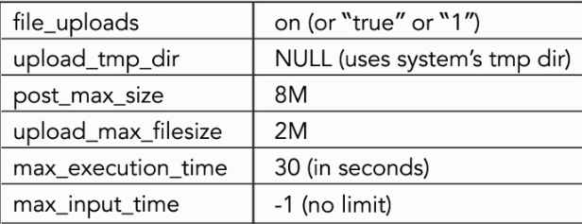
Configuring php for file uploads
Php.ini uploading checklist

Slide 3
Sending files as form data
<form action="file_uploading.php" method="post" enctype="multipart/form-data">
<input type="file" name="uploading" />
<input name="submit" type="submit" />
</form>

Slide 4
Super Global variable for Files
As we used up to now the following Super Global variables:
  $_GET
  $_POST
  $_REQUEST
  $_SESSION
There are some other super global variable also but here now we use another Super Global variable i.e. $_FILES.

Slide 5
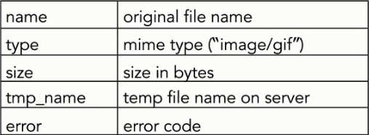
$_FILES
$_FILES[ ‘uploading’ ]
Keys in the associate array
  Example: $_FILE[‘uploading’][name]

Slide 6
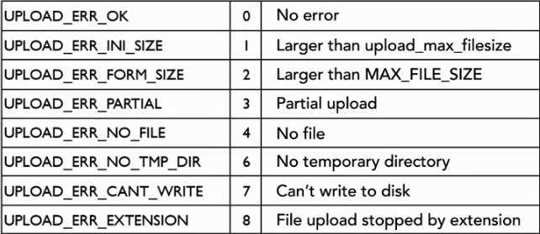
File upload errors
Followings are the file upload errors

Slide 7
Error Messages Explained
UPLOAD_ERR_OK
Value: 0; There is no error, the file uploaded with success.
UPLOAD_ERR_INI_SIZE
Value: 1; The uploaded file exceeds the upload_max_filesize directive in php.ini.
UPLOAD_ERR_FORM_SIZE
Value: 2; The uploaded file exceeds the MAX_FILE_SIZE directive that was specified in the HTML form.
UPLOAD_ERR_PARTIAL
Value: 3; The uploaded file was only partially uploaded.

Slide 8
Error Messages Explained
UPLOAD_ERR_NO_FILE
Value: 4; No file was uploaded.
UPLOAD_ERR_NO_TMP_DIR
Value: 6; Missing a temporary folder. Introduced in PHP 5.0.3.
UPLOAD_ERR_CANT_WRITE
Value: 7; Failed to write file to disk. Introduced in PHP 5.1.0.
UPLOAD_ERR_EXTENSION
Value: 8; A PHP extension stopped the file upload. PHP does not provide a way to ascertain which extension caused the file upload to stop; examining the list of loaded extensions with phpinfo() may help. Introduced in PHP 5.2.0.

Slide 9
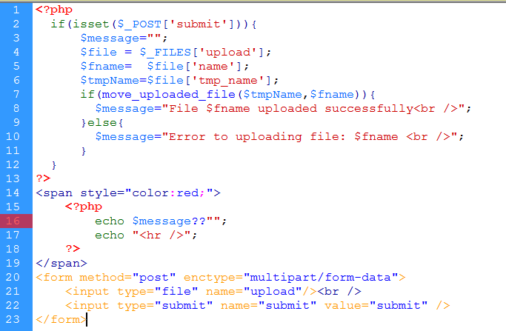
File upload Example: (single file upload)

Slide 10
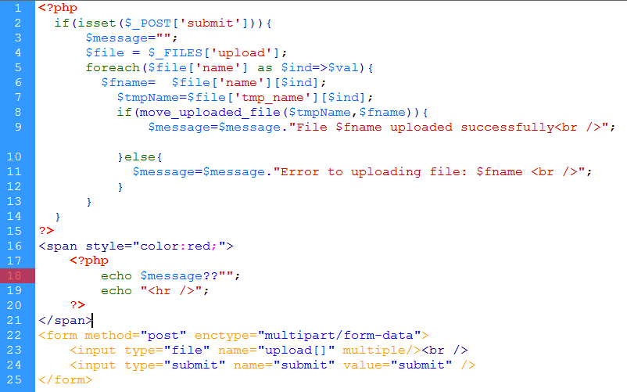
File upload Example: (multiple file upload)

Slide 11
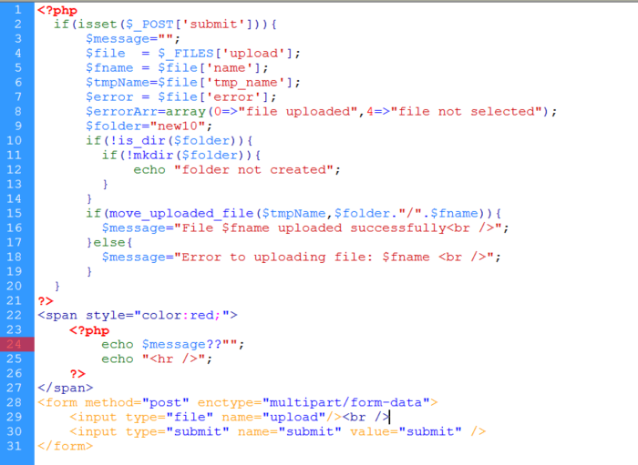
File upload Example:

Slide 12
Accept Attribute
The accept attribute specifies the types of files that the server accepts (that can be submitted through a file upload).
The accept attribute can only be used with <input type="file">.
Do not use this attribute as a validation tool. File uploads should be validated on the server.
Example:
<form action=“action.php“ method=“post” enctype=“multipart/form-data”>
<input type="file" name="pic" accept="image/*">
<input type="submit">
</form>

Slide 13
Accept Attribute
Attribute Values can be the following.
Value | Description
file_extension | A file extension starting with the STOP character, e.g: .gif, .jpg, .png, .doc
audio/* | All sound files are accepted
video/* | All video files are accepted
image/* | All image files are accepted

Slide 14
Assignments

